Slide 1
GrowSmart -An ML based Intelligent Recommendation System for Crops and Fertilizers
Under the Guidance of
Dr. S. Kusuma
By
R M Sai Mohit (19699A0544)
M Madhusudhan (19699A0524)
B Jagadeesh (19699A0517)
K V Hari Prasad (19699A0513)
Computer Science and Engineering
Madanapalle Institute of Technology and Science
Andhra Pradesh

Slide 2
CONTENTS
Abstract
Problem Definition
Objectives
Literature Survey
Architecture
UML Diagram
Data flow Diagram
Model Design
Database Design
Dataset
List of features
Heat Map
Algorithms Used
Test and Train Accuracies
Algorithm with high Accuracy
Web Application
References

Slide 3
ABSTRACT
Agriculture is a major source of income and employment in India. The most prevalent problem faced by Indian farmers is that they do not select the appropriate crop for their land and do not use the appropriate fertilizer. They will experience a significant drop in production as a result of this. GrowSmart has been used to solve the farmers difficulties. GrowSmart is a modern farming strategy that employs research data on soil properties, soil types, and crop yield statistics to recommend the best crop to farmers as well as fertilizer recommendations. This decreases the number of times a crop is chosen incorrectly and increases productivity. The aim of this analysis is to develop a system which helps the farmers to recommend a crop for the site specific parameters with high accuracy and efficiency with the help Machine Learning (ML) approaches.

Slide 4
PROBLEM DEFINATION
In India, agriculture is one of the most important professions. Many of the people do agriculture but are unable to determine which types of crops are more suitable to their soil. Means there are variety of crops which are only suitable for wet soil, some requires medium humidity in the soil to grow but this knowledge is less known to farmers as well as newbies who develop some interest in farming. As of now there are very less resources as well as software’s which will help them to improve quality. Such type of software is “GROWSMART”.

Slide 5
OBJECTIVES
To build a robust model to provide correct and accurate prediction of crop sustainability in a given state for the particular soil type and climatic conditions.
To build user friendly and interactive application.
Provide recommendation of the most effective suitable crops within the area in order that the farmer doesn't incur any losses.
Provide fertilizer suggestion for crops supported chemical features.
Provide Pesticide recommendation System for crops.
To built a best fertilizer and pesticide store.

Slide 6
EXISTING SYSTEM
Existing system are restricted to few algorithms only.
Highest accuracy of existing system is Random Forest which ranges from 93 %
The User alone can see the crops that are recommended based on the input.
Existing system uses only few parameters.
Existing system does not contain Pesticide Recommendation System and Store.

Slide 7
PROPOSED SYSTEM
We are going to use 7 best machine learning algorithms and we will take the best algorithm for recommendations.
After finding the highest accuracy algorithm that is used for testing new data.
New data is entered using Web Interface and it will recommend the crops, fertilizers and pesticides based on the input and provides suggestions.
The user can visit Fertilizer & Pesticide store.

Slide 8
LITERATURE SURVEY
AUTHOR | YEAR | TITLE | SOURCE | METHODOLOGY USED
Aditya Param Patil Vatsa Nagaria Shobhit Sunil Ghane | 2022 | Soil Analysis and Crop Recommendation using Machine Learning | www.ieee.org (Institute of Electrical and Electronics Engineers) | CNN Random Forest
Daneshwari Ashok V Vijayalaxmi Anupama | 2022 | Crop Recommendation Using Machine Learning Algorithm | www.ieee.org (Institute of Electrical and Electronics Engineers) | SVM
Soham Chakraborty Sushruta Mishra | 2022 | A Smart Farming-Based Recommendation System Using Collaborative Machine Learning and Image Processing | Springer | XGboosting Naive Bayes KNN Random Forest

Slide 9
LITERATURE SURVEY
AUTHOR | YEAR | TITLE | SOURCE | METHODOLOGY USED
Shilpa prem kumar anmol anmol aishwarya karuna rohilla Kumar shaurya | 2021 | Crop Recommender System Using Machine Learning Approach | www.ieee.org (Institute of Electrical and Electronics Engineers) | SVM Random Forest KNN Linear Regression
Shariff Shwetha R B Ramya O G Pushpa H Pooja K R | 2022 | Crop Recommendation using Machine Learning Techniques | www.ijert.org (International journal of engineering research & technology) | Decision Tree Naïve Bayes Gradient Boosting KNN Random Forest
Abhinav Sharma Muskaan Bhargava Akshay Vijay | 2022 | AI-Farm: A crop recommendation system | www.ieee.org (Institute of Electrical and Electronics Engineers) | Decision tree Naive Bayes Logistic Regression Random Forests

Slide 10
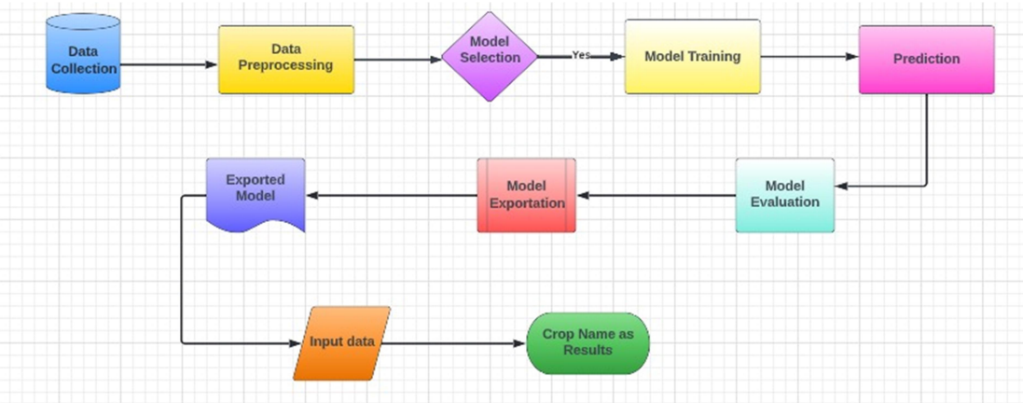
ARCHITECTURE

Slide 11
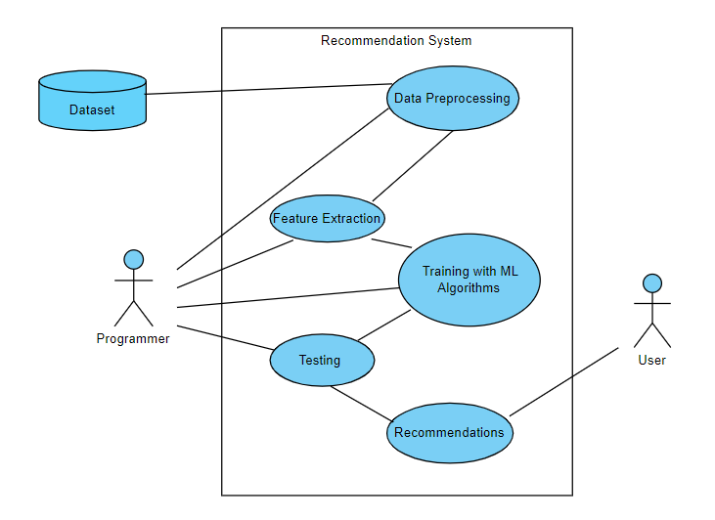
UML DIAGRAM
Use Case Diagram
(Programmer End)

Slide 12
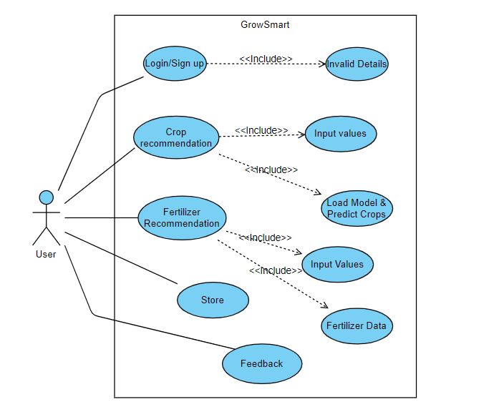
UML DIAGRAM
Use Case Diagram
(User’s End)

Slide 13
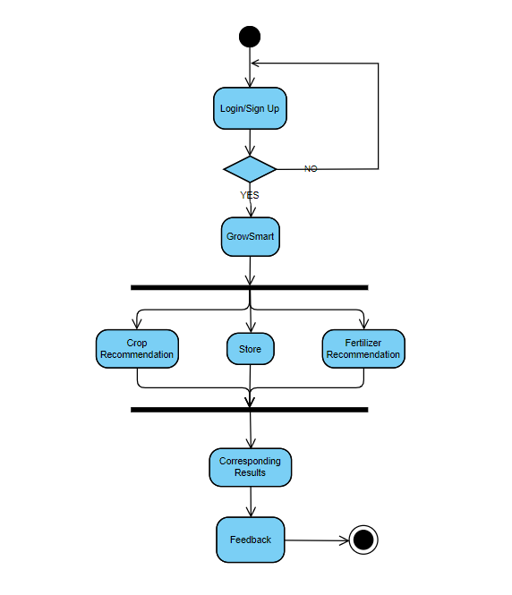
UML DIAGRAM
Activity Diagram (User’s End)

Slide 14
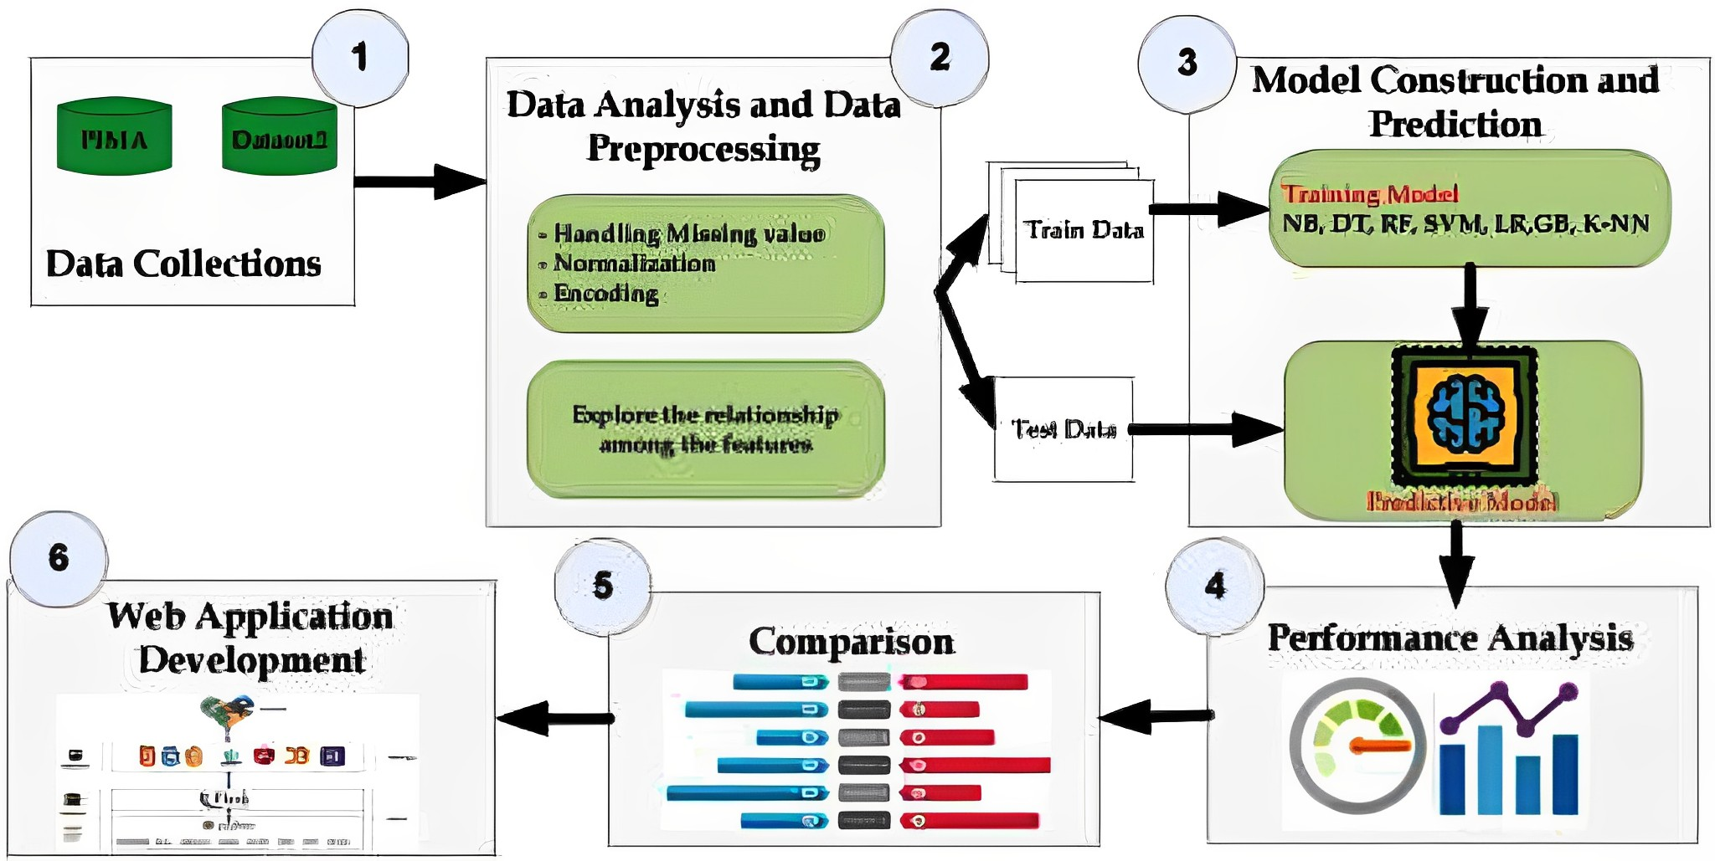
DATA FLOW DIAGRAM
Dataset

Slide 15
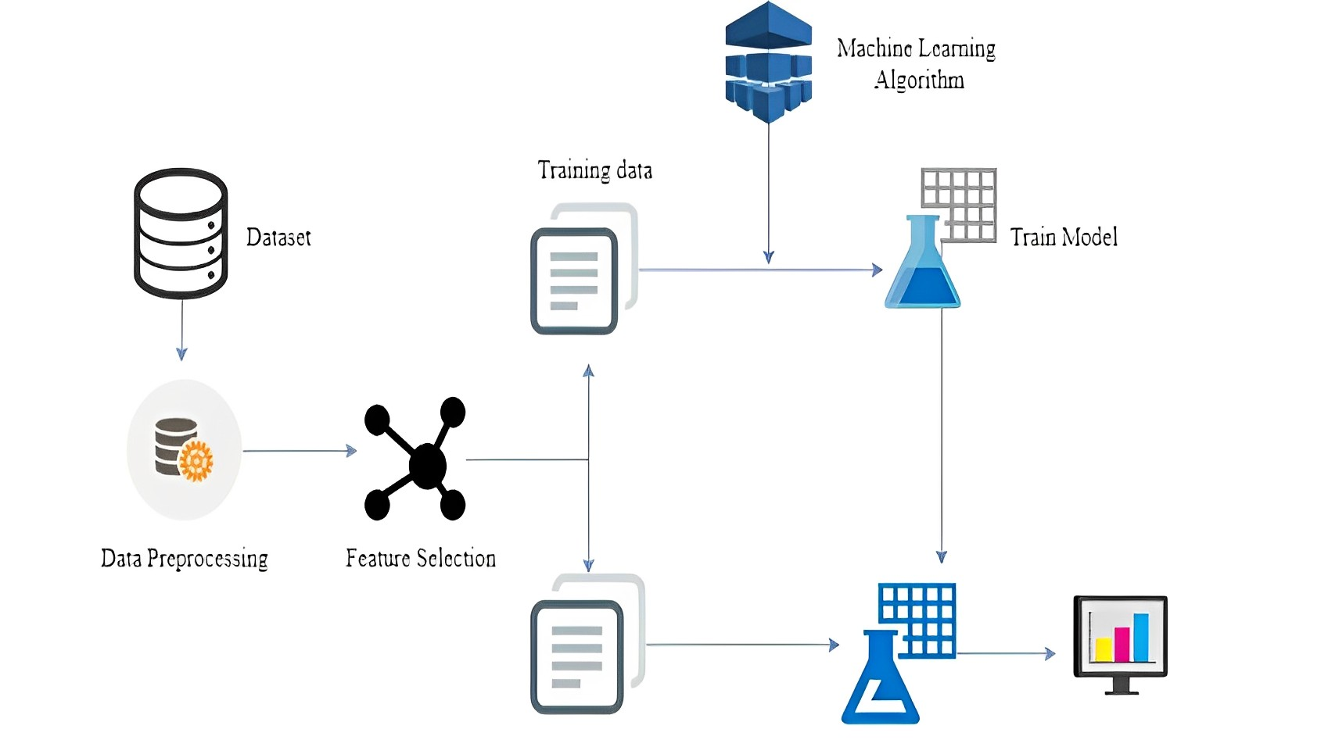
MODEL DESIGN

Slide 16
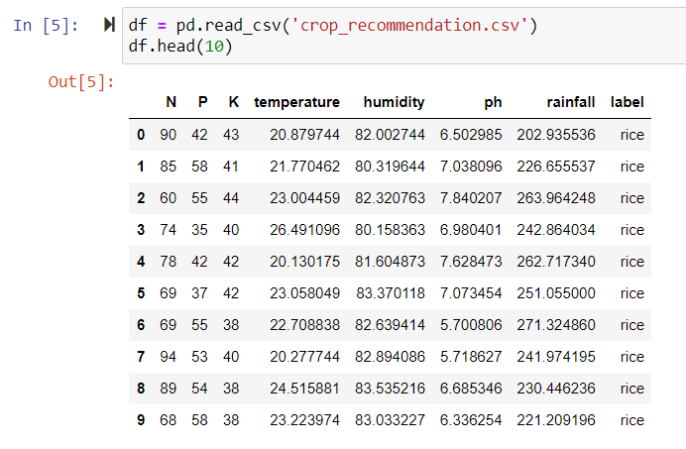
DATASET
The datasets consists of several parameters and one target label i.e. Outcome. Parameters includes their NPK values, Temperature, ph and so on.

Slide 17
LIST OF FEATURES
Features | Description
N | Nitrogen content in the soil.
P | Phosphorous content in the soil.
K | Potassium content in the soil.
Temperature | Temperature of the Environment.
pH | pH value of Soil.
Humidity | Humidity of the Environment.
Rainfall | Rainfall of the Environment.

Slide 18
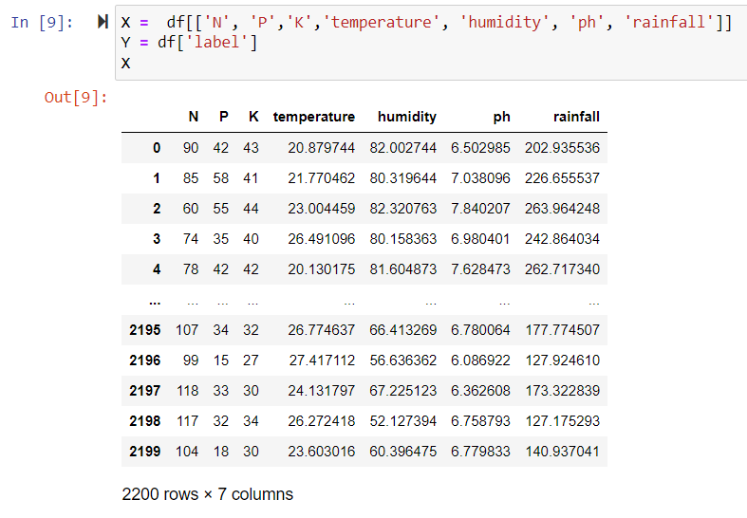
LIST OF FEATURES
These are the features, we used to train and test for our Machine Learning model.

Slide 19
ALGORITHMS USED
Logistic Regression
K Nearest Neighbours
Random Forest
Support Vector Machine
Naive’s Bayes Algorithm
Decision Tree
Gradient Boosting

Slide 20
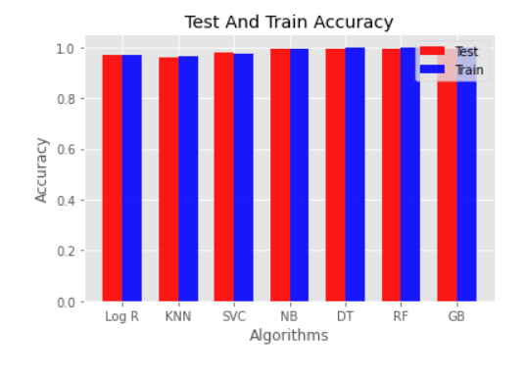
TEST AND TRAIN ACCURACIES

Slide 21
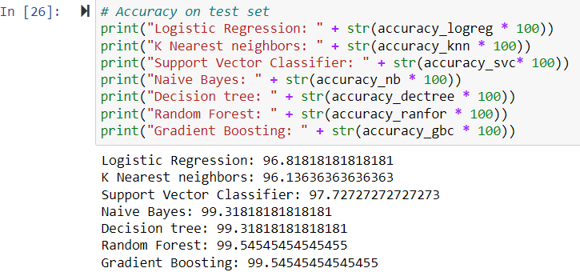
ACCURACY OF ML ALGORITHMS

Slide 22
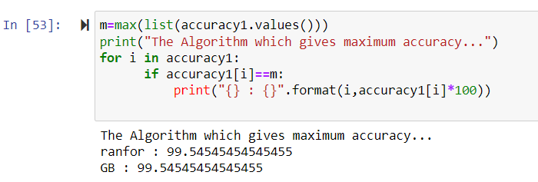
FINDING ALGORITHM WITH HIGH ACCURACY
We have found that, “Random Forest Algorithm” and “Gradient Boosting” are achieving the highest accuracy among all the algorithms.

Slide 23
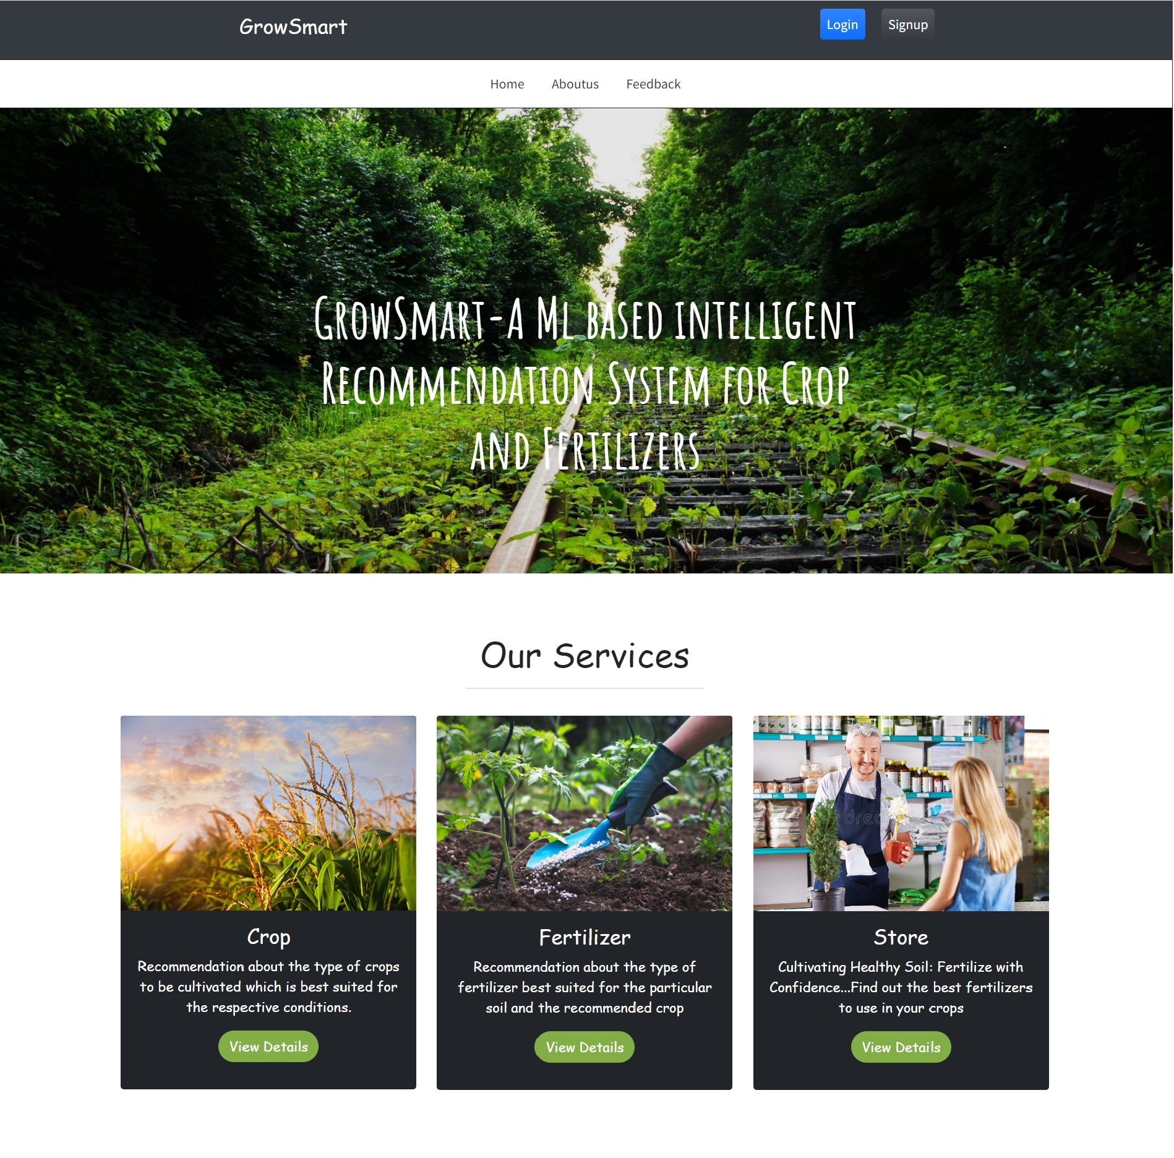
WEB APPLICATION
GrowSmart Home Page

Slide 24
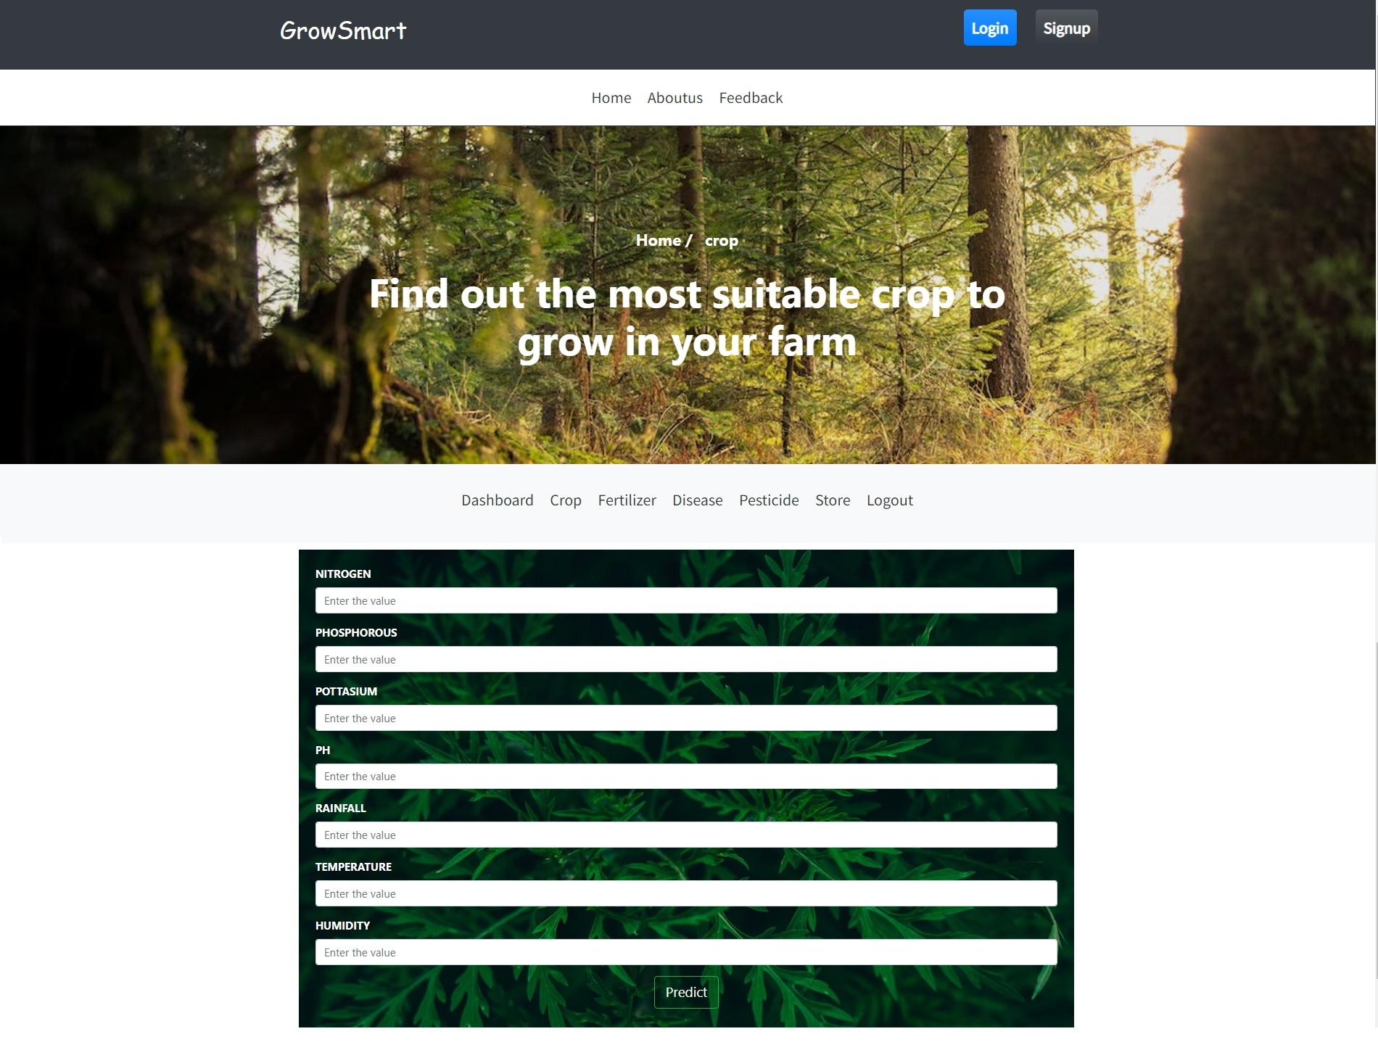
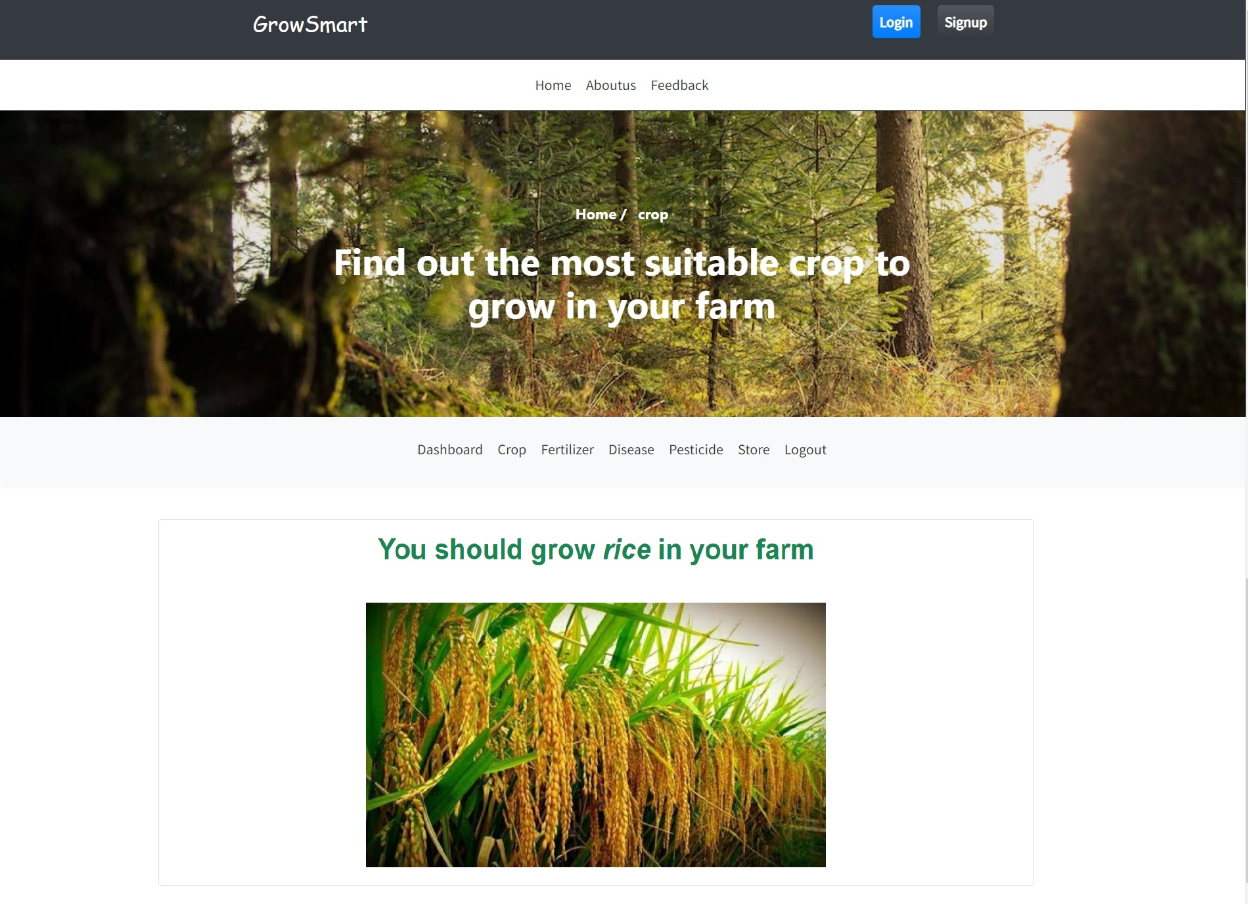
WEB APPLICATION
Crop Recommendation System
Crop Recommendation Result

Slide 25
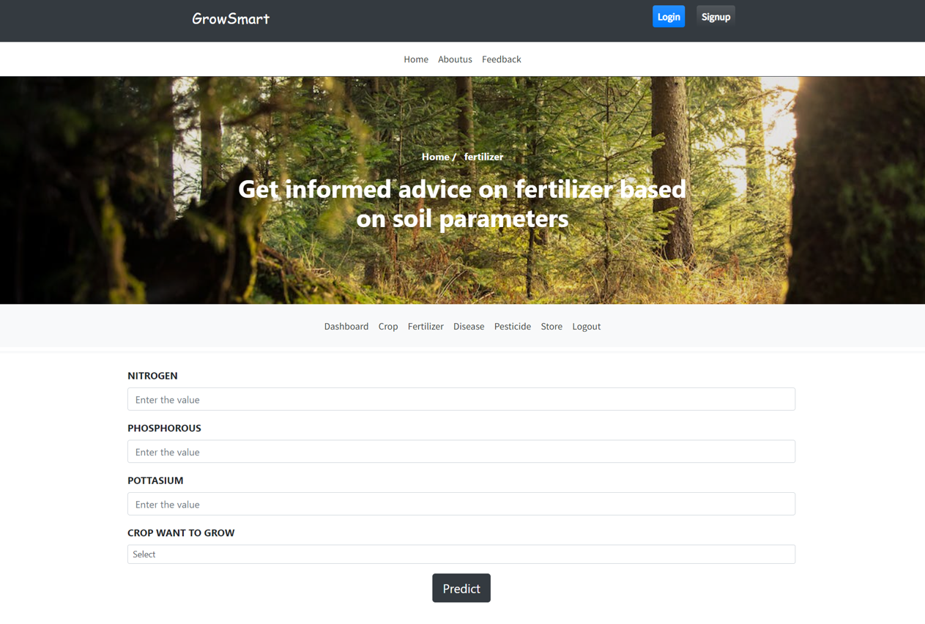
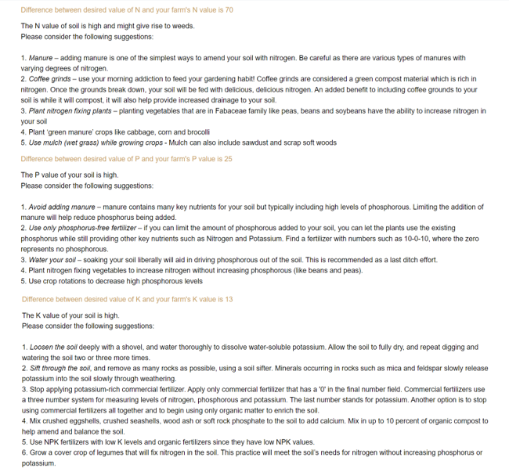
WEB APPLICATION
Fertilizer Recommendation System
Fertilizer Recommendation Result

Slide 26
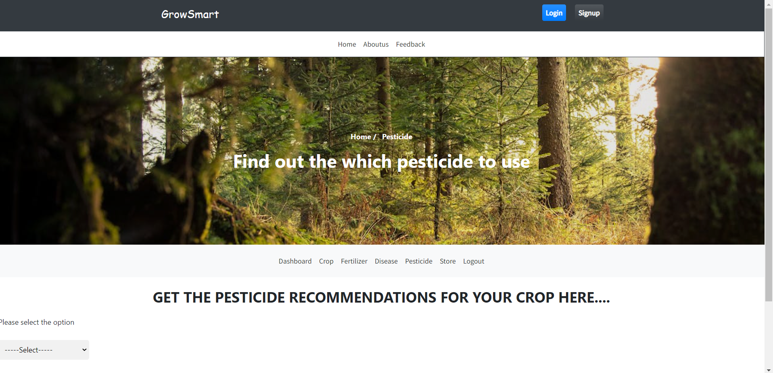
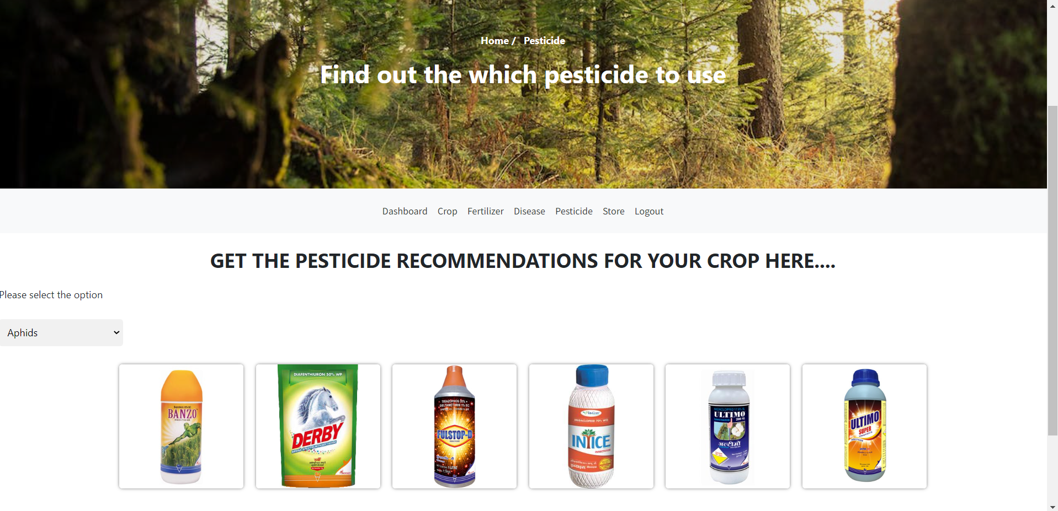
WEB APPLICATION
Pesticide Recommendations System
Pesticide Recommendation Result

Slide 27
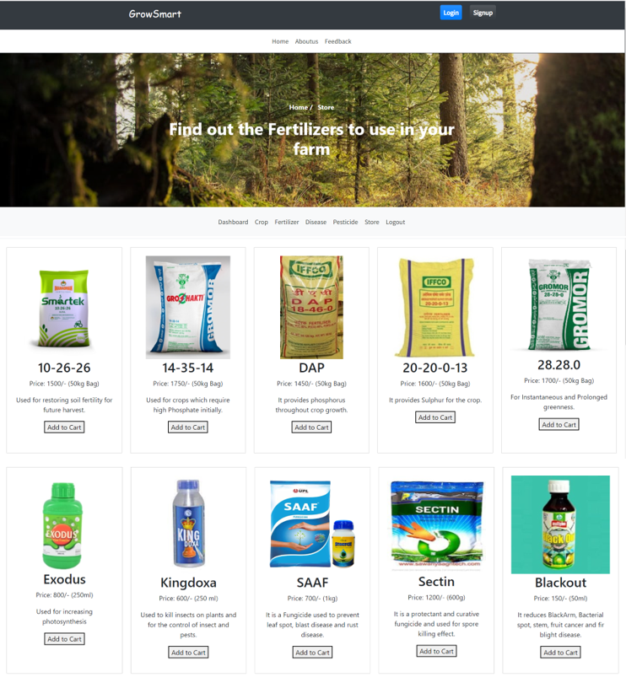
WEB APPLICATION
GrowSmart Fertilizer & Pesticide Store

Slide 28
FUTURE WORK
GrowSmart currently supports 22 crops and we will be add other crops. Moreover, in the future, fertilizers can also be added accordingly.
In Crop Recommendation, values are manually entered by user of temperature, humidity, rainfall. Admin can also use some weather API to fetch the real time parameters by the city and state.
In Pesticide Recommendation, we have only provided only pesticide suggestions based on pest here we can improve it by detecting the pest using DL methods and provide recommendations based on the results and pesticide code can be integrated with drone code so that it can take live pictures of pests and by email or by mobile the farmers would be notified about the pest along with the pesticides.
We will be incorporating more Machine Learning and Deep learning models for achieving better results.

Slide 29
REFERENCES
[1] Aditya, Param Patil, Vatsa Nagaria, Shobhit , Sunil Ghane’s “Soil Analysis and Crop Recommendation using Machine Learning” in Institute of Electrical and Electronics Engineers(IEEE) in 2022.
[2] Daneshwari ,Ashok V, Vijayalaxmi Anupama’s “Crop Recommendation Using Machine Learning Algorithm” in Institute of Electrical and Electronics Engineers(IEEE) in 2022.
[3] Shilpa, prem kumar , anmol anmol, Aishwarya,karuna rohilla, Kumar shaurya’s “Crop Recommender System Using Machine Learning Approach” in Institute of Electrical and Electronics Engineers(IEEE) in 2021.

Slide 30
REFERENCES
[4] Soham Chakraborty and Sushruta Mishra’s “A Smart Farming-Based Recommendation System Using Collaborative Machine Learning and Image Processing” in Springer in 2022.
[5] Shariff, Shwetha R B, Ramya O G, Pushpa H, Pooja K R’s “Crop Recommendation using Machine Learning Techniques” in International journal of engineering research & technology ICEI – 2022 (Volume 10 – Issue 11) in 2022.
[6] Abhinav Sharma, Muskaan Bhargava, Akshay Vijay’s “AI-Farm: A crop recommendation system” in Institute of Electrical and Electronics Engineers(IEEE) in 2022.

Slide 31
REFERENCES
[7] R. Kumar, M.P. Singh, P. Kumar and J.P. Singh, “ Crop Selection Method to Maximize Crop Yield Rate using Machine Learning Technique,” in Proc. 2015 Int. Conf. Smart Technol. and Manage. for Comput., Commun., Controls, Energy and Mater.
[8] A. T. M. S. Ahamed et al., “Applying data mining techniques to predict annual yield of major crops and recommend planting different crops in different districts in Bangladesh,” in Proc. 2015 IEEE/ACIS 16th Int. Conf. Soft. Eng., Artif. Intell., Netw. and Parallel/Distrib. Comput.
[9] M. Paul, S.K. Vishwakarma and A. Verma, “Analysis of Soil Behaviour and Prediction of Crop Yield using Data Mining Approach,” in Proc. 2015 Int. Conf. Comput. Intell. and Commun. Netw.

Slide 32
THANK YOU

